Slide 1

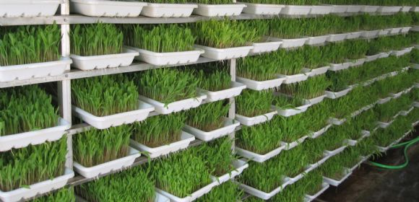
MINI PROJECT PHASE- 1 PRESENTATION
DESIGN & DEVELOPMENT OF IOT BASED FARMING SOLUTION
Dept. of Electronics and Instrumentation
By-
Siddesha GV (1RV13IT018)
Karthik HG (1RV13IT022)
Shanthilal K (1RV13IT046)
Vasishta HD (1RV13IT058)
Under the guidance of-
Mr. Sandesh R S
Dept. of Electronics and Instrumentation

Slide 2
MOTIVATION
There is a requirement for a completely automated IoT based
hydroponics system which helps to reduce human intervention.
Currently there are no systems to provide data analysis of type and yield of the crop and the corresponding seasonal and climatic conditions.
PROBLEM STATEMENT
The problem of water scarcity and a efficient use of water in irrigation is very much necessary. Automation and analytics in the field of agriculture helps farmers in decision- making regarding the crop rotation and soil fertility management.
Hence these problems are addressed in the system that is going to be developed.

Slide 3
METHODOLOGY
Power Supply
Sensors
(Humidity , Temp, level, etc)
Processing and Computation -
Atmega328
Motors and pumps
LCD Display
Communication module-
Wi- Fi
Data Logging to a cloud storage and control
(Web browser)
Controller- AVR microcontroller- Atmega 328 (8bit)
Development IDE- Arduino
Wi-Fi modules-ESP8266
GSM module- SIM900A

Slide 4
APPLICATIONS AND OUTCOMES
Water usage efficiency- alterable timings
Save time and money over long run
Better yield of plants
IoT based system provides real time monitoring
Database management helps in data analytics
Potential application in artificial intelligence
Hydroponics- a novel system in India to be implemented at a large scale.
Application in home based farming.
Lesser area-more growth

